Slide 1
Welcome to Kindergarten!
2020-2021

Slide 2
Tonight's Agenda (items to be discussed)
Standards
Curriculum
District Assessments – RI/DIBELS
Classroom Assessments
GKIDS
Goal Setting
Reading Resources
Tech Tips
Copyright Resources
Contact Information

Slide 3
Grade Level Standards
All lessons adhere to GA Standards of Excellence for all subjects
Math –
Unit 1
Unit 2
Unit 3
Unit 4
Unit 5
Unit 6
ELA - https://www.georgiastandards.org/Georgia-Standards/Frameworks/ELA-Kindergarten-Developmental-Progressions-R-W-SL-L.pdf

Slide 4
Curriculum – Reading/ELA
Dialogic Reading – Teacher reads aloud to students and focuses on developing oral language and vocabulary.
Word Study – Decoding and Spelling
Poem – Phonemic Awareness (Rhyming, Syllables, Substituting Sounds), Concepts of Print
Interactive Read Aloud – Teacher reads aloud to students exposing children to rich language, developing comprehension ability, expanding vocabulary, and building knowledge.
Writing - Kindergarten Rubrics for Narrative, Opinion, and Informational

Slide 5
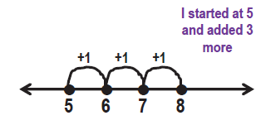
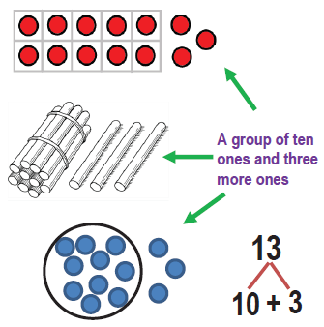
Curriculum - Math
Kindergarten Number Talks Brochure
Math Workshop – Recognizing Numbers, Counting, Word problems with addition and subtraction

Slide 6
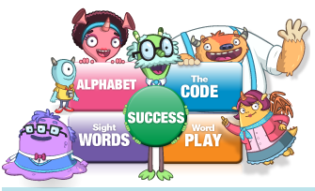
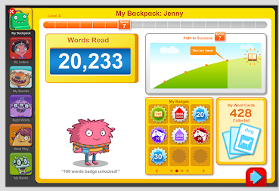
iRead
Meets the students where they are in their instructional literacy level.
Students log on during DI.

Slide 7
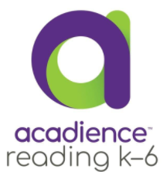
District Assessments –
The Reading Inventory is taken on a computer and lasts about 20 minutes. The types of questions a student receives and the results that are reported are based upon the student’s grade level and reading level.
Test Administration –2 times a year (December, May)
DIBELS is administer one on one with a teachers. The items assist teachers in monitoring students phonemic (letter sounds) and phonological (letters, blending) skills.
Test Administration – 3 times a year (August, December, May)

Slide 8
GKIDS 2.0
The Georgia Kindergarten Inventory of Developing Skills 2.0 (GKIDS 2.0) is a yearlong, progression-based formative assessment. GKIDS 2.0 is aligned to the Georgia Standards of Excellence (GSE) for kindergarten and is organized around big ideas and learning progressions.
GKIDS 2.0 will:
• Measure your child’s knowledge and skills in up to seven areas of learning
• Help teachers plan instruction
• Help families understand their child’s progress over time
Parent Flyer with Domains of Learning, Learning Progressions,
Performance Levels
GKIDS Parent Website– https://gkidsparent.gadoe.org/Pages/Home.aspx
video summary included on site

Slide 9
Goal Setting
G - Growth
O - Ownership
A - Awareness
L - Learning
“Setting goals is the first step in turning the invisible into the visible.”
-Tony Robbins
Leverage parent support: If we want students (especially our youngest ones) to set goals that have any personal meaning, those goals need to be transferrable from school to home. In this sense, parents are a key player. Goals that are meaningful for both students and parents are key in fostering long-term growth.
-Journal of Research in Childhood Education

Slide 10
Grade Level Goal
Kindergarten Goal –
Read CVC words
(consonant, vowel, consonant – i.e. cat, tip, run, dog)
WAYS TO ASSIST AT HOME
Let your child log onto Education Galaxy at home.
Practice letter and sound recognition with your student each night.
Find letters in stories you are reading or places you go.
Use letter magnets, shaving cream, or sticky notes to make it fun!
If your student has mastered letter and sound recognition –
Play games with CVC words - Trash Ball (Game in Gym tonight), Swat It!
Use letter magnets, shaving cream, or sticky notes to write or create the words!
Read aloud to your child each night.

Slide 11
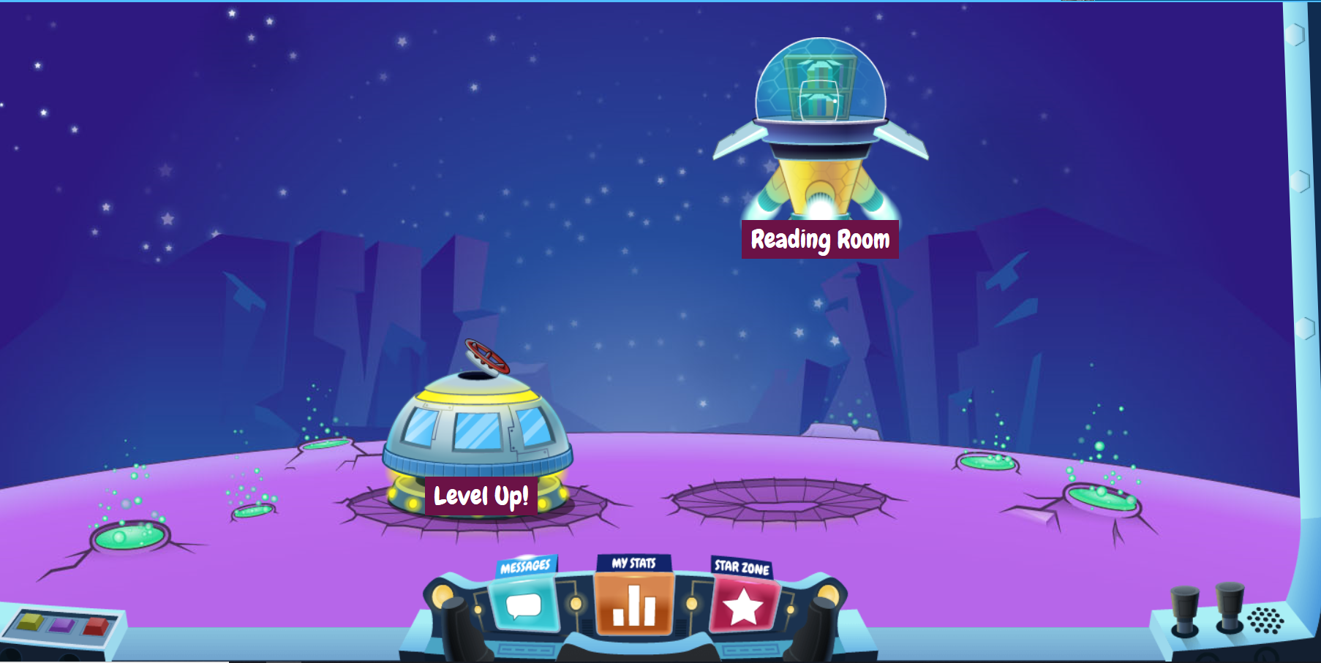
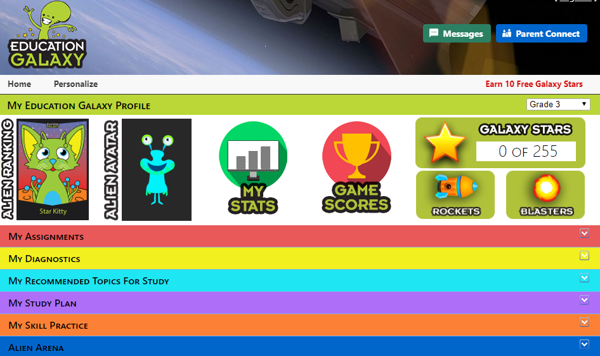
Reading Resources
RazKids - https://www.raz-kids.com/
Online practice on literacy standards and skills
Teacher login: Contact Teacher
Student login: Lunch number
Education Galaxy – www.educationgalaxy.com
Students can practice Reading Standards in an engaging online setting.
Student login – Student ID # + hes (i.e. 123456hes)
Student Password – Student ID # (i.e. 123456)

Slide 12
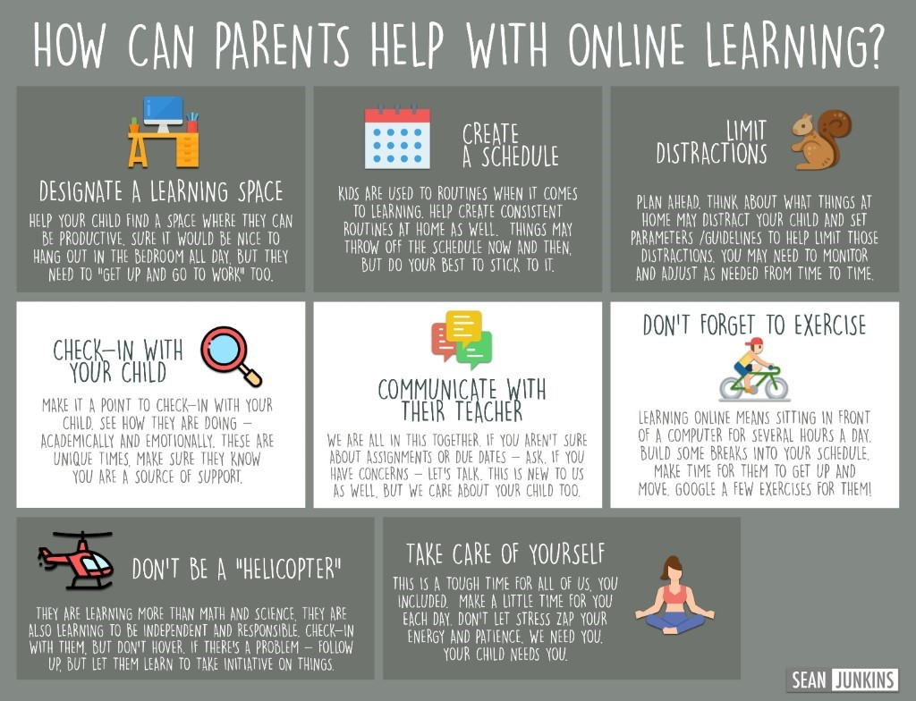
Tech Tips –Online Learning

Slide 13
Tech Tips – cont’d
Canvas Student Login –
Student login - Student ID # @paulding.k12.ga.us
(i.e. 12345@paulding.k12.ga.us)
Student Password – first initial + middle initial + last initial and 4 digit birthday (month and day)
(i.e. abc0102)
Canvas Parent Help Guides - https://community.canvaslms.com/t5/Observer-Guide/tkb-p/observer
Information for Digital Learning Days – short term and/or long term (pivot) - https://www.paulding.k12.ga.us/Page/42513

Slide 14
What is Copyright?
Did you know that whenever you write a poem or story or even a paper for your class, or a drawing or other artwork, you automatically own the copyright to it. Copyright is a form of protection given to the authors or creators of "original works of authorship," including literary, dramatic, musical, artistic and other intellectual works. What that means is that, as the author of the work, you alone have the right to do any of the following or to let others do any of the following:
- make copies of your work;
- distribute copies of your work;
- perform your work publicly (such as for plays, film, dances or music);
- display your work publicly (such as for artwork, or stills from audiovisual works, or any material used on the Internet or television); and
- make “derivative works” (including making modifications, adaptations or other new uses of a work, or translating the work to another media).
In general, it is illegal for anyone to do any of the things listed above with a work created by you without your permission, but there are some exceptions and limitations to your rights as a copyright holder. One major limitation is the doctrine of “Fair Use”.
Student Guide for more information on copyright - http://www.copyrightkids.org/cbasicsframes.htm
Parent Guidance for more information on copyright - https://parentingdigital.com/parents-guide-copyright-fair-use/

Slide 15
Contact Information
Feel free to reach out to your child’s teacher with questions.
You may also contact your school’s Instructional Lead Teacher:
2020 Title I Schools

